Slide 1

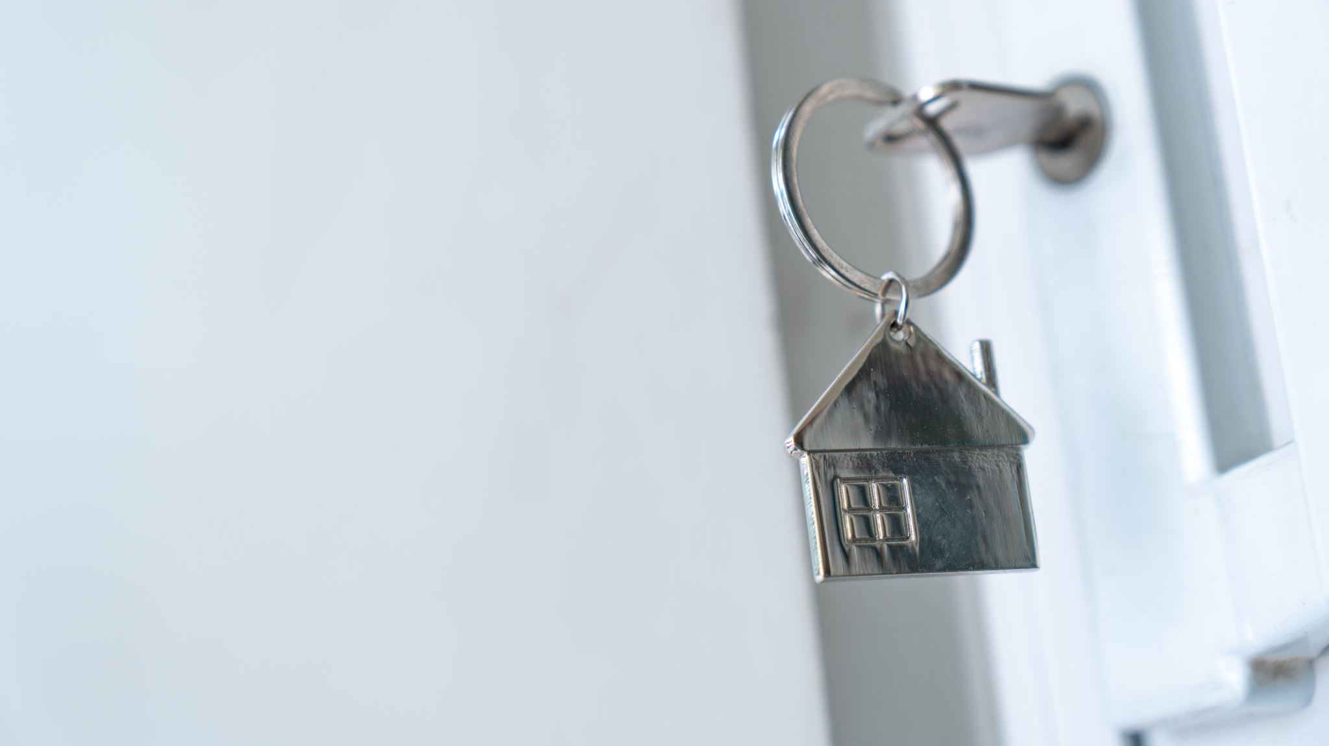
Home Security System:
Hiram Y. Miranda Pomales
ELEN 442-447

Slide 2
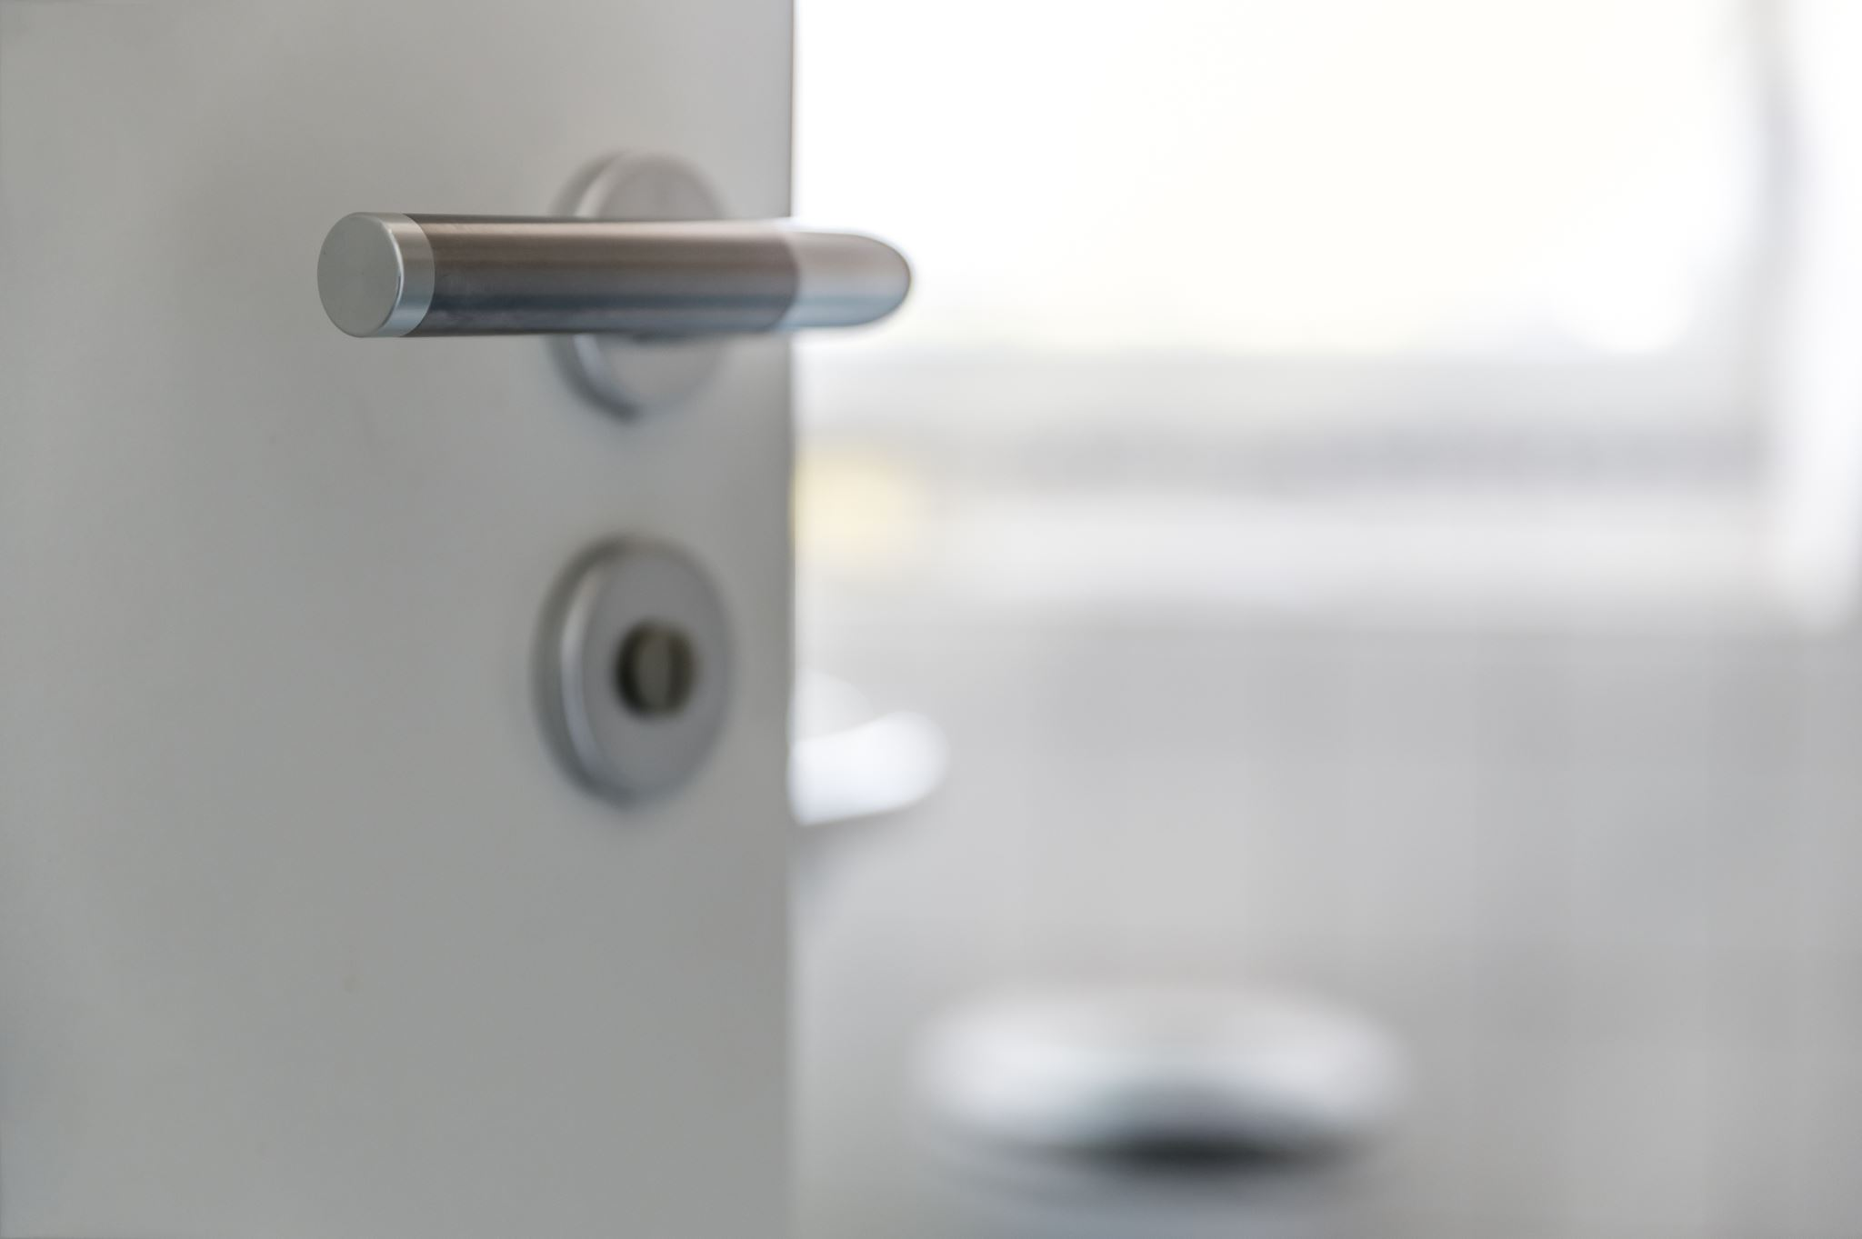
Introduction
For this final project, we are proud to present a sophisticated home security system that seamlessly integrates IoT technology. The core components of this system include the ESP32 microcontroller, Blynk platform, and strategically placed door and window reed switches. To further fortify security, a servo is employed for efficient door control. This sophisticated system is designed to swiftly detect any potential intruders, triggering immediate notifications to the user, while also triggering an alarm. Simultaneously, it captures a snapshot, storing it on an SD card for later reference. An additional layer of security is provided by enabling control over the door lock, as well as facilitating the seamless activation and deactivation of the entire security system.

Slide 3

Design Details
Our design facilitates the use of:
ESP32 for Wi-Fi integration and IOT control
2 magnetic reed switch
micro servo motor
Active Buzzer
ESP32-Cam
2 LEDs
Micro SD card
Card
Blynk integration

Slide 4
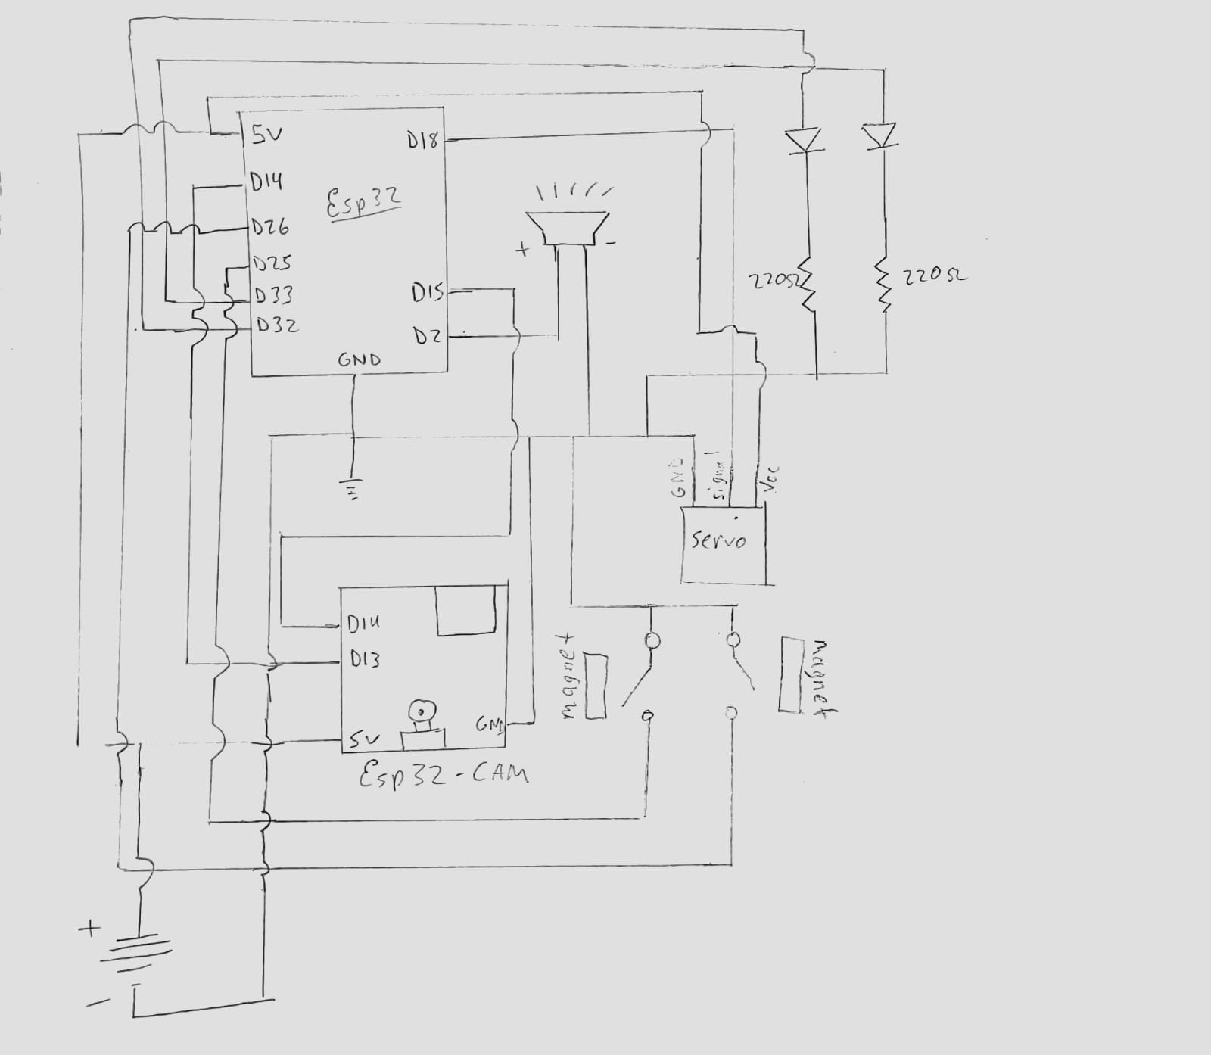
Circuit Design
ESP32: Employed for Wi-Fi integration and IoT control, serving as the central hub for system communication.
Magnetic Reed Switches (2): Utilized as door and window sensors (connected to pins DOOR_SENSOR and WINDOW_SENSOR), providing input to detect the state of doors and windows.
Servo Motor: Connected to pin 18 (servoPin), responsible for controlling the movement of a physical barrier or camera orientation.
Active Buzzer: Connected to the buzzer pin (pin 2), used to generate audible alerts or alarms based on system events.
ESP32-Cam: Integrated into the system via UART pins, extending the functionality with a camera for surveillance purposes.
LEDs (2): Two LEDs are incorporated for visual indications. The red LED is connected to pin 32 (ledPinClose), serving as an indicator for closed status. The green LED is connected to pin 33 (ledPinOpen), indicating an open status.
Micro SD Card: Connected to the ESP32-Cam, providing a secure and local storage solution for captured images.
Resistors (220 Ohm): Connected to the cathodes of the LEDs to limit current flow. The anodes of the LEDs are connected to pin 32 (red LED) and pin 33 (green LED).
Figure 1: Circuit Sketch

Slide 5
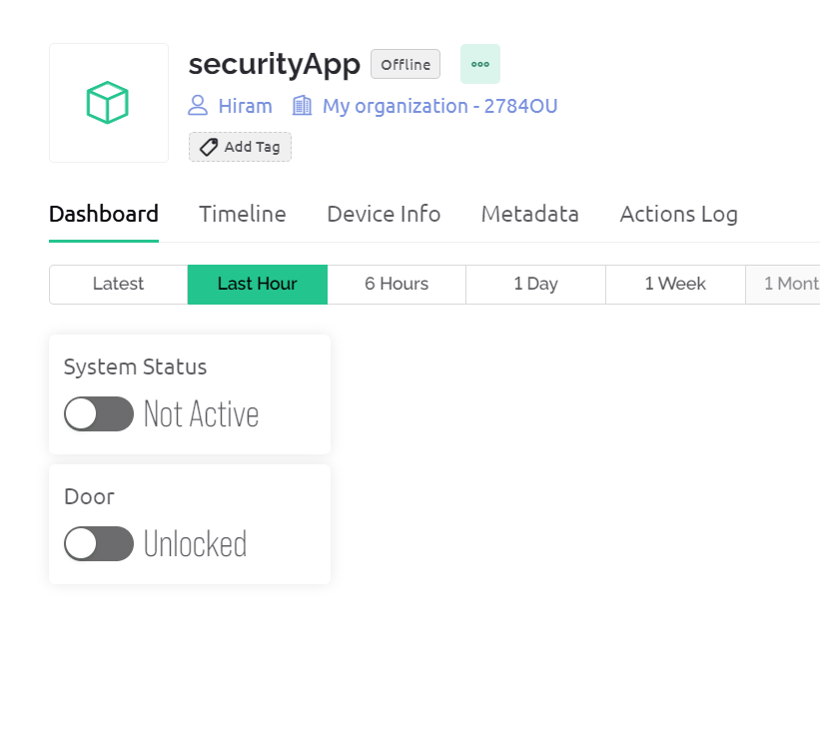
Application Design: Main Web Console
Figure 2: Web Console

Slide 6
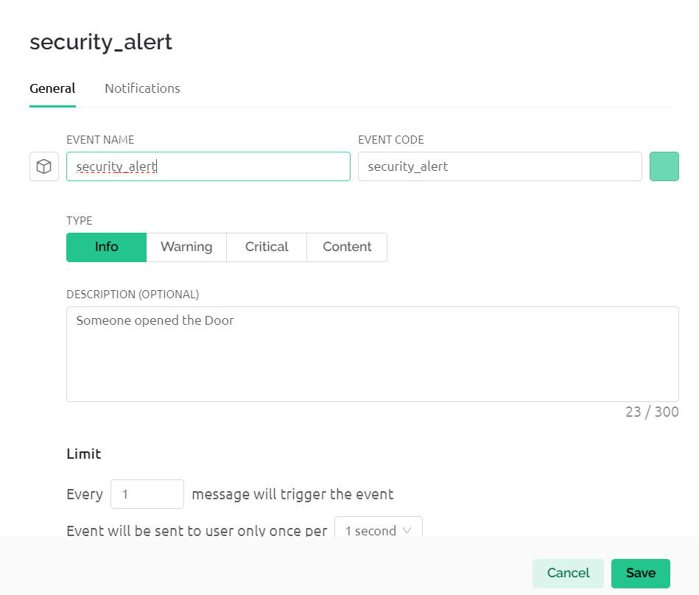
Application Design: Notification Event
Figure 3: notification integration

Slide 7
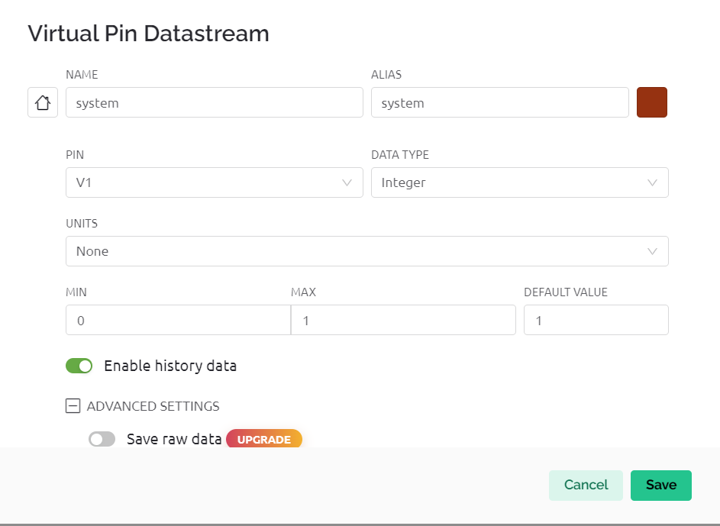
Application Design: System Status DataStream
Figure 4: System DataStream

Slide 8
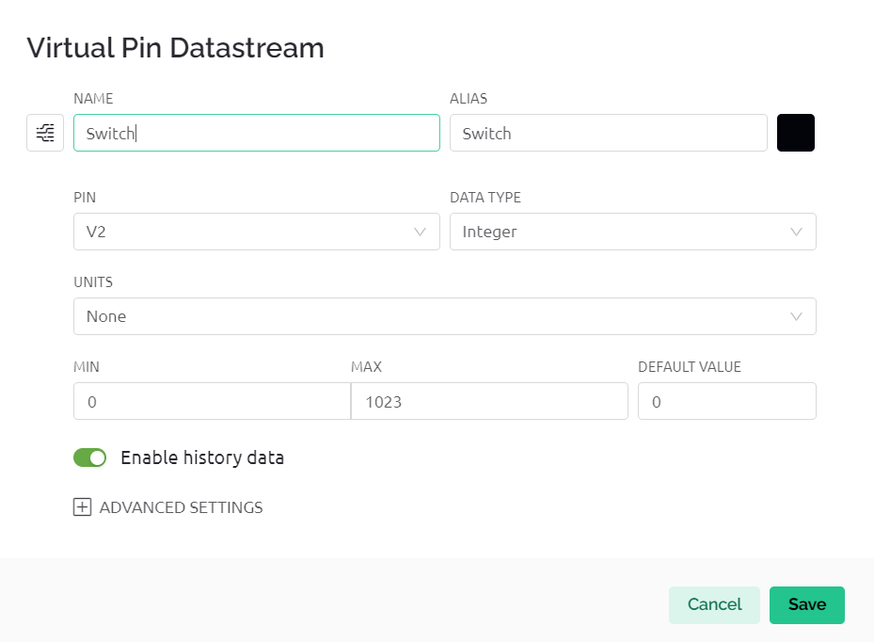
Application Design: Door Status Datastream
Figure 5: Door DataStream

Slide 9
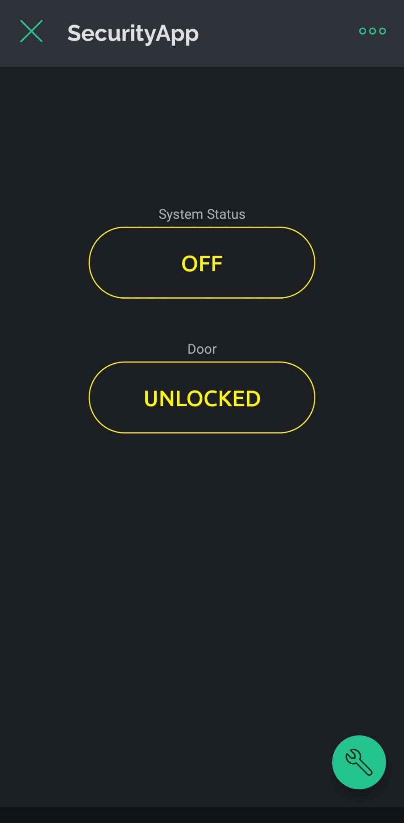
Application Design: Phone App
Figure 6: Phone App integration

Slide 10
Design Constraints
In this project, a significant design constraint arises from the limited availability of pins on the ESP32-CAM. To overcome this limitation, an ESP32 is employed, connected to the ESP32-CAM via UART pins. This approach allows for the efficient utilization of available resources.
Another constraint encountered is related to data storage. Initially, the plan was to create a web page to which the captured photos could be sent for easy access at any time. However, complications arose during the implementation, and the ESP32 faced difficulties connecting to the designated page. As a result, an alternative solution was sought, leading to the adoption of Firebase Storage. However, issues persisted during the photo upload process to the storage, prompting a reevaluation of the system's architecture.
To address the challenges and ensure a more private and secure system, a decision was made to leverage an SD card for photo storage. This shift not only resolves the issues encountered with the web-based solution but also provides a robust and reliable method for storing captured images, ensuring the project's overall success and functionality.

Slide 11
Installing libraries
To embark on programming the ESP32 using the Arduino IDE, we need to configure the necessary preferences and integrate essential libraries into our project. Start by launching the Arduino IDE and navigating to "File" -> "Preferences." In the "Additional Boards Manager URLs" field, include the following URL:
https://raw.githubusercontent.com/espressif/arduino-esp32/gh-pages/package_esp32_index.json
Next, we'll install the ESP32 board package by heading to "Tools" -> "Board" -> "Boards Manager." Within the Boards Manager, utilize the search bar to locate "ESP32" and proceed to install the "esp32" package developed by Espressif Systems.
With the ESP32 board package successfully integrated into our project, the next step is to include the requisite libraries. Access the Library Manager by navigating to "Sketch" -> "Include Library" -> "Manage Libraries." In the Library Manager, search for and install the following libraries: "BlynkSimpleEsp32" for Blynk integration and "ESP32Servo" for efficient control of servo motors.

Slide 12
Code Overview: ESP32
Blynk Information:
Specifies the Blynk template ID, template name, and authentication token for the Blynk app.
Library Inclusions:
Includes necessary libraries for WiFi, Blynk, and the ESP32Servo library for servo motor control.
Pin Definitions:
Defines GPIO pins for UART communication, door and window sensors, a buzzer, and pins for LEDs and a servo motor.
Servo Setup:
Initializes a servo motor and specifies its control pin, as well as pins for LEDs indicating the open and closed states.
Sets up parameters related to servo movement.
Blynk Credentials:
Specifies the Blynk authentication code and WiFi credentials (SSID and password).
flag is a variable used for tracking events.
Blynk Event for V1:
Listens for a Blynk app event on Virtual Pin V1.
Changes the system state (on/off) based on the received value.
Blynk Event for V2:
Listens for a Blynk app event on Virtual Pin V2.
Controls the servo motor based on the received value.
Reads the state of door and window sensors.
If the door or window is open, and the system is in an armed state (systemState == 1), it triggers a security alert.
Logs the event in Blynk, activates a buzzer, and sends a 'C' command over UART.
Setup Function:
Initializes Serial communication, Blynk connection, and the servo motor.
Allocates timers for PWM (Pulse Width Modulation).
Configures pins for sensors, LEDs, and the buzzer.
Sets up a timer interval for the notifyOnButtonPress function to be called every 5 seconds.
Loop Function:
Runs Blynk and the timer loop.
Notification Function

Slide 13
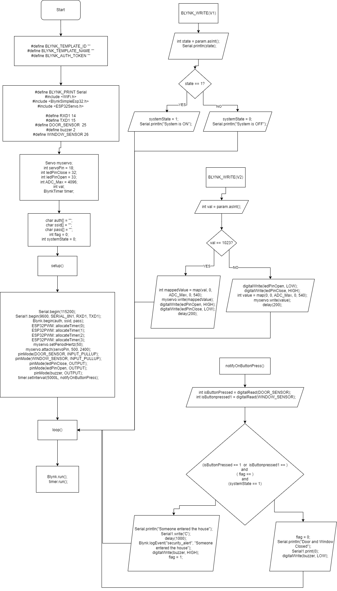
Flowchart: ESP32
Figure 7: Start ESP32 Flowchart
Figure 8: setup() part ESP32 Flowchart

Slide 14
Flowchart: ESP32
Figure 9: System status ESP32 Flowchart
Figure10: Door status ESP32 Flowchart

Slide 15
Flowchart: ESP32
Figure 10: Notification Event ESP32 Flowchart

Slide 16
Code Overview: ESP32-CAM
Library Inclusions:
Includes necessary libraries for ESP32 camera and MicroSD functionality.
Pin Definitions:
Defines the GPIO pins for camera module connectivity, MicroSD, and UART communication.
Camera Configuration:
Configures the ESP32 camera module with specific pin assignments, frame size, pixel format, and other settings.
Adjusts camera quality parameters such as brightness, contrast, saturation, and white balance.
MicroSD Initialization:
Initializes the MicroSD card and checks for its presence.
Camera Initialization:
Disables the brownout detector.
Initializes the Serial Monitor for debugging.
Initializes the camera module and MicroSD card.
Main Loop:
Monitors for a command ('C') from Serial1 (UART communication) indicating a request to capture a photo.
Image Capture:
Upon receiving the 'C' command, it generates a unique path for the image file based on the picture count.
Captures an image from the camera module and saves it to the specified path on the MicroSD card.
The captured image is in JPEG format.
Serial Communication:
The code listens for commands from an external source, presumably connected through the Serial1 port.
Delay:
The setup function prints the delay time in milliseconds, which is set to 10,000 milliseconds (10 seconds).
Brownout Detector:
Disables the brownout detector, which can be useful in scenarios where the power supply might be unstable.

Slide 17
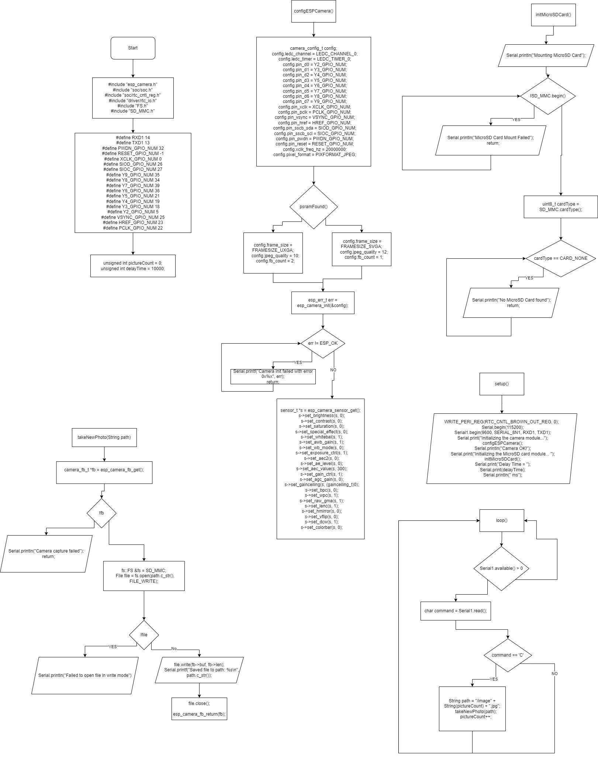
Flowchart: ESP32-CAM
Figure 11: ESP32-Cam Flowchart part 1
Figure 12: ESP32-Cam Flowchart part 2

Slide 18
Flowchart: ESP32-CAM
Figure 13: ESP32-Cam Flowchart part 3

Slide 19
Flowchart: ESP32-CAM
Figure 14: ESP32-Cam Flowchart part 4
Figure 15: ESP32-Cam Flowchart part 5

Slide 20
Flowchart: ESP32-CAM
Figure 15: ESP32-Cam Flowchart part 5

Slide 21
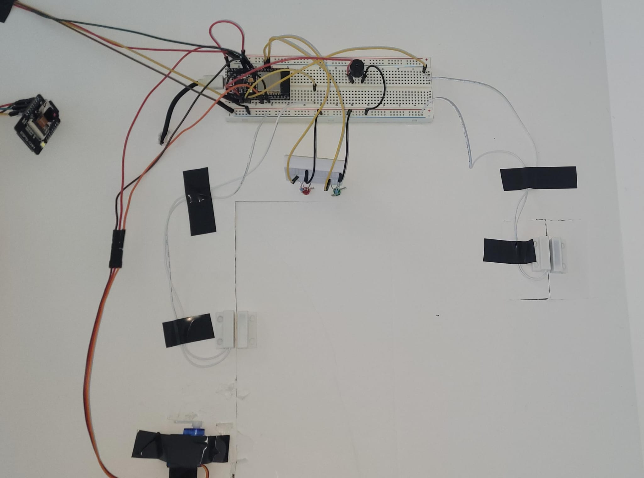
Design verification: Circuit( Back view)
Figure 16: Full Circuit

Slide 22
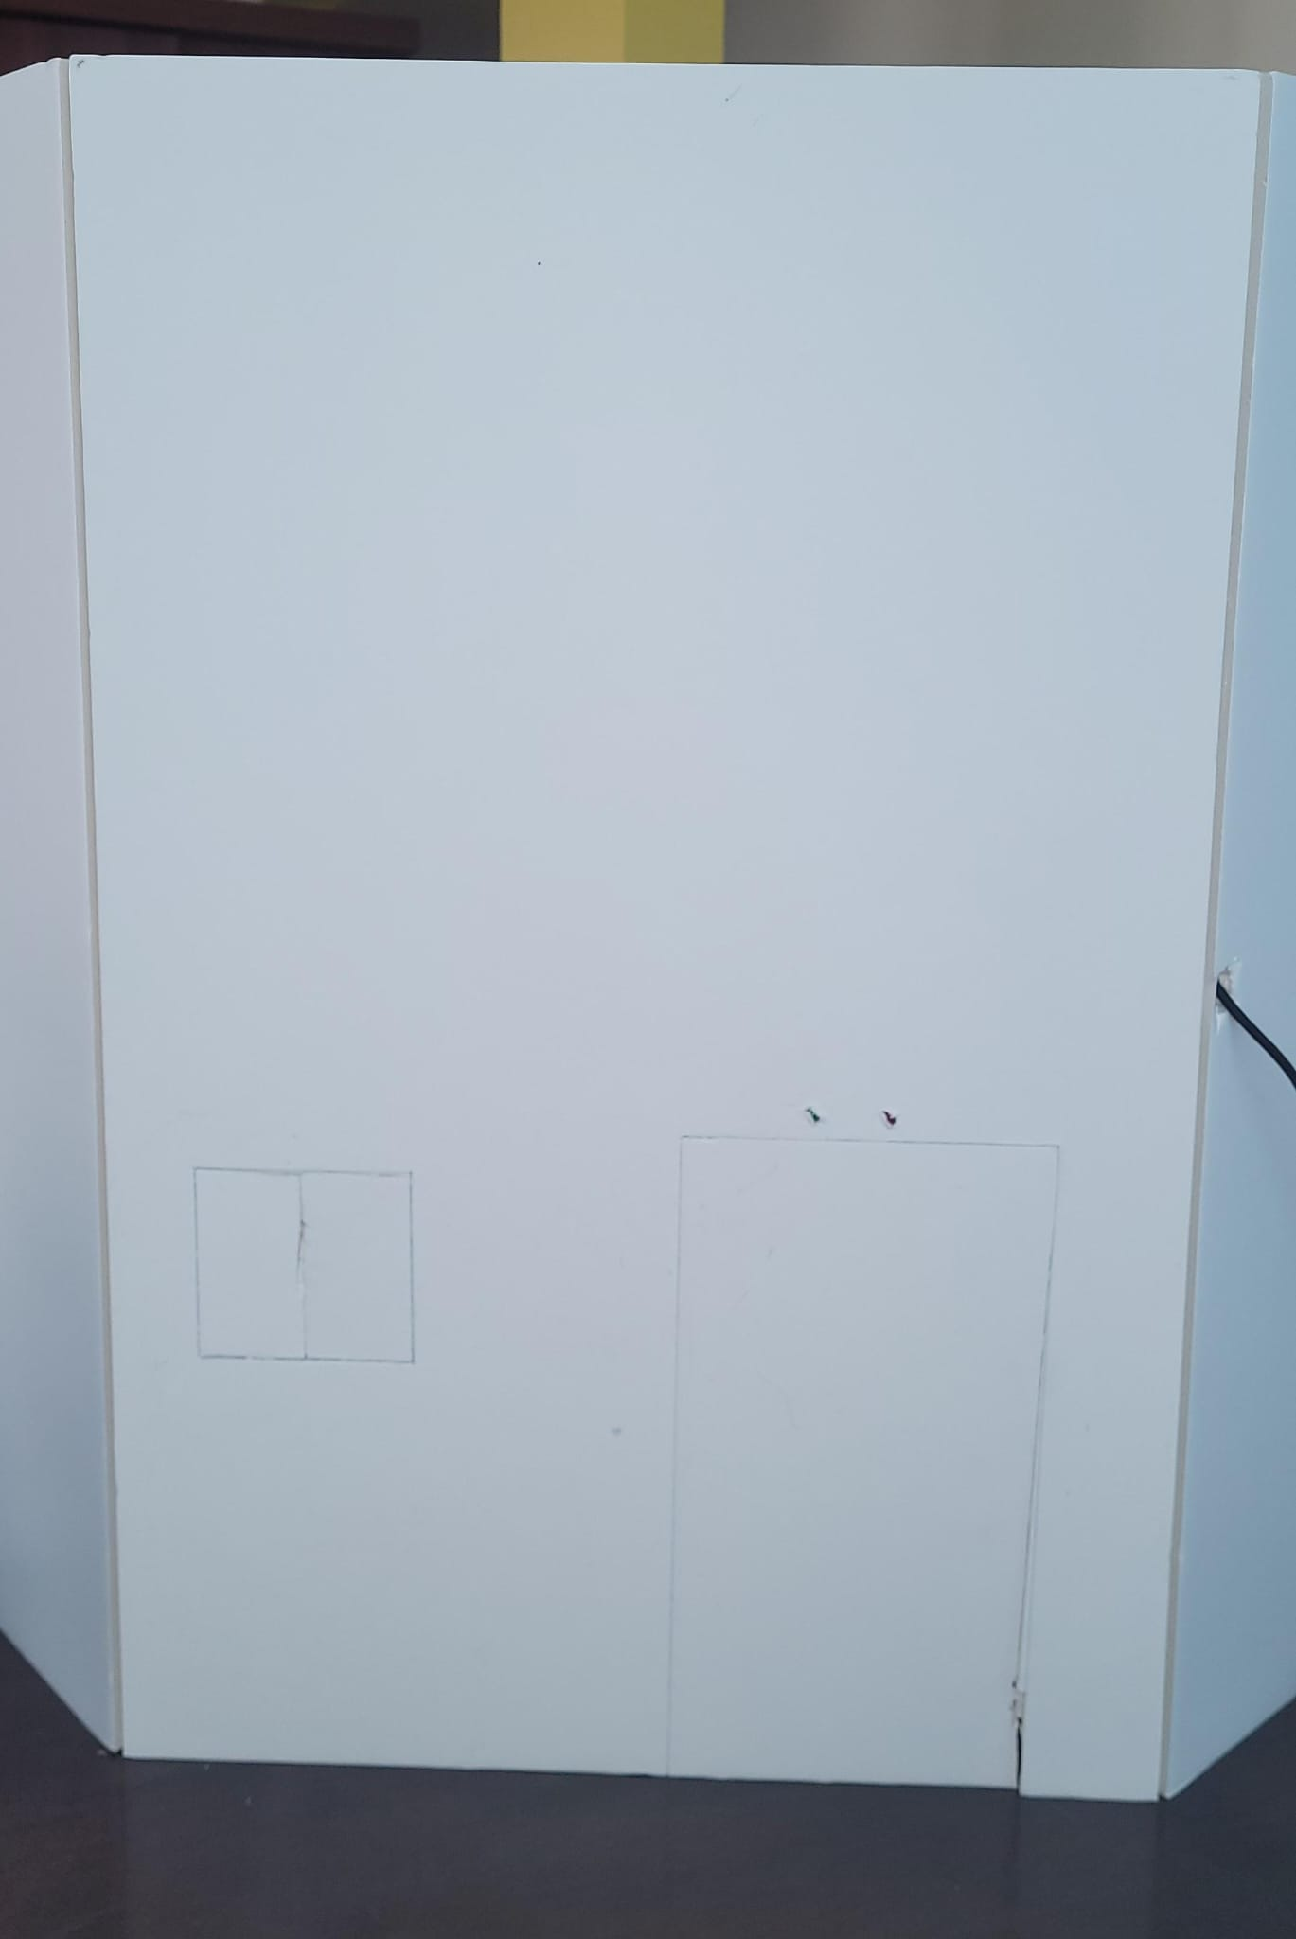
Design verification: Circuit( Front view)
Figure 17: Design Front View

Slide 23
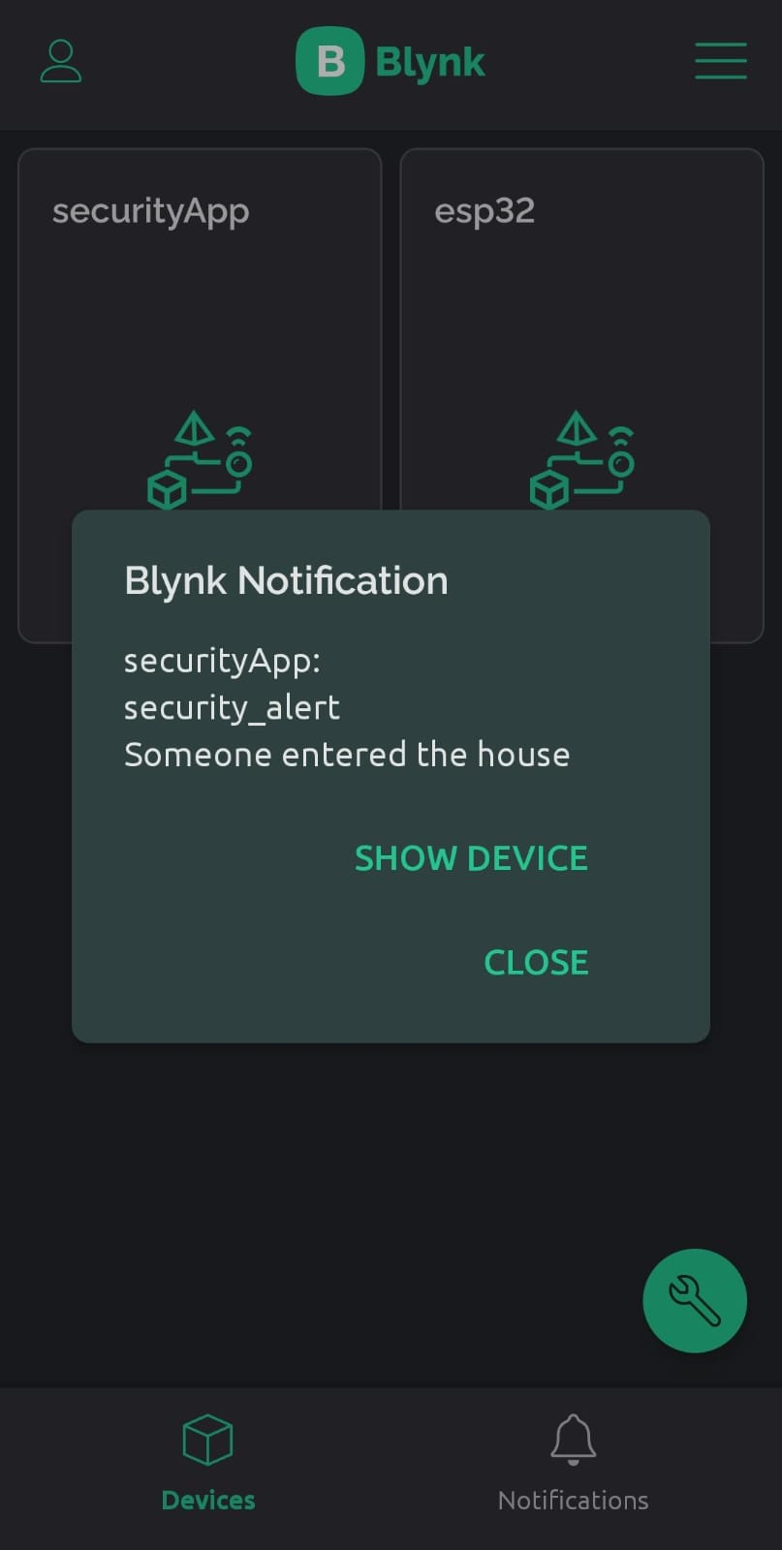
Design verification: Notification
Figure 18: Notification Alert

Slide 24
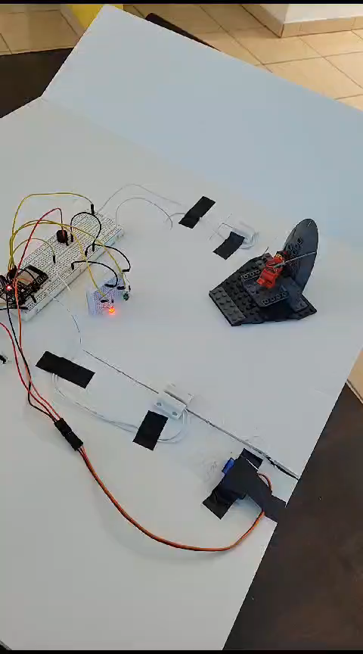
Home Security System Video
Video 1: Working Circuit

Slide 25
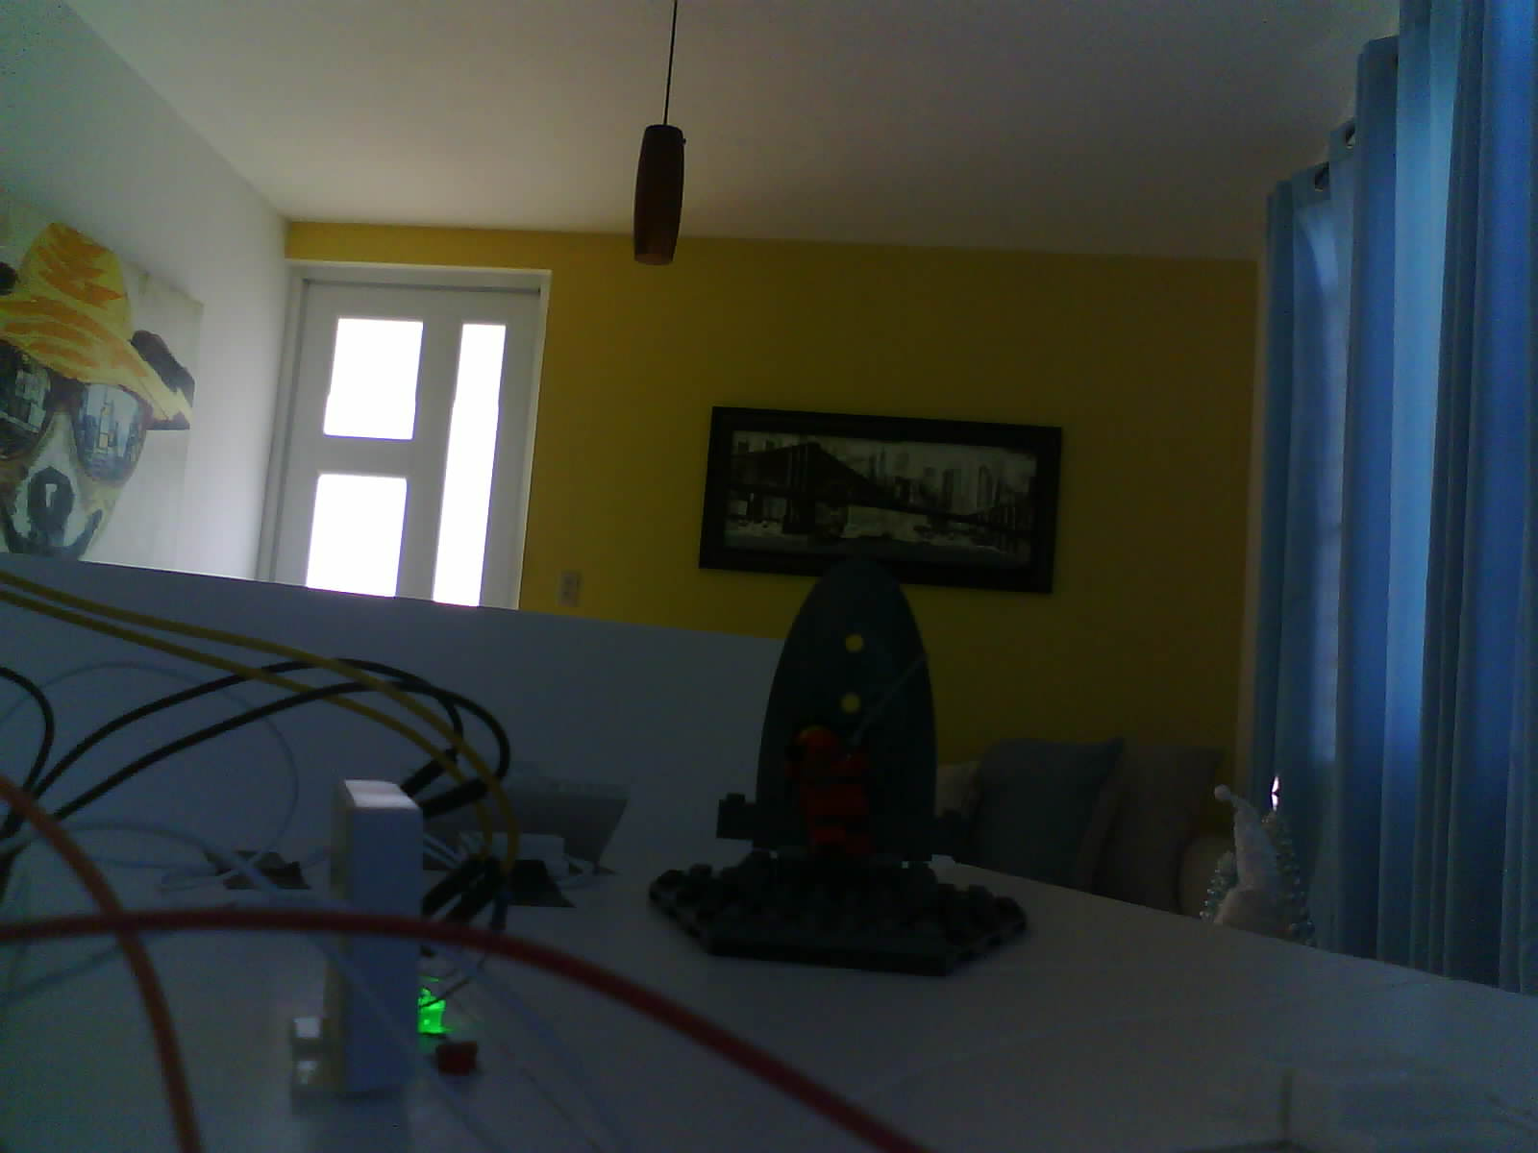
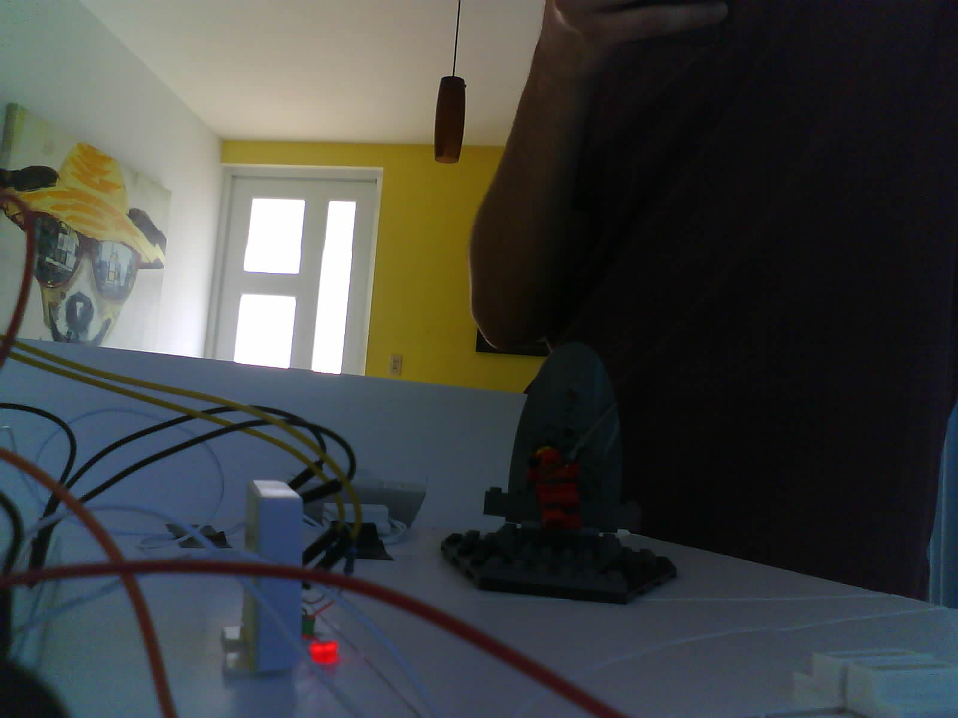
Photos taken
Figure 21: ESP32-Cam Fhoto 1
Figure 22: ESP32-Cam Fhoto 2

Slide 26
Cost Analysis
Item | Quantity | Price per 1
ESP32 | 1 | ≈ $9.99
ESP32-CAM | 1 | ≈$10.00
Reed Switch | 2 | ≈$3.64
Active Buzzer | 1 | ≈$0.70
Micro servo Motor | 1 | ≈$2.00
Bread Board | 1 | ≈$6.50
Mini Bread Board | 1 | ≈$1.08
Micro SD | 1 | ≈$12.00
Card Reader | 1 | ≈$11.70
Jumper Wires | 5 | ≈$0.18
Dupont Wires | 16 | ≈0.05
Resistors( 220 ohm) | 2 | ≈0.06
LED | 2 | ≈0.02
In summary, the total estimated cost for the components required for the Home Security project is approximately $62.11. These calculations consider the quantity and unit price for each item, providing a comprehensive overview of the budget required for the implementation of the project.

Slide 27
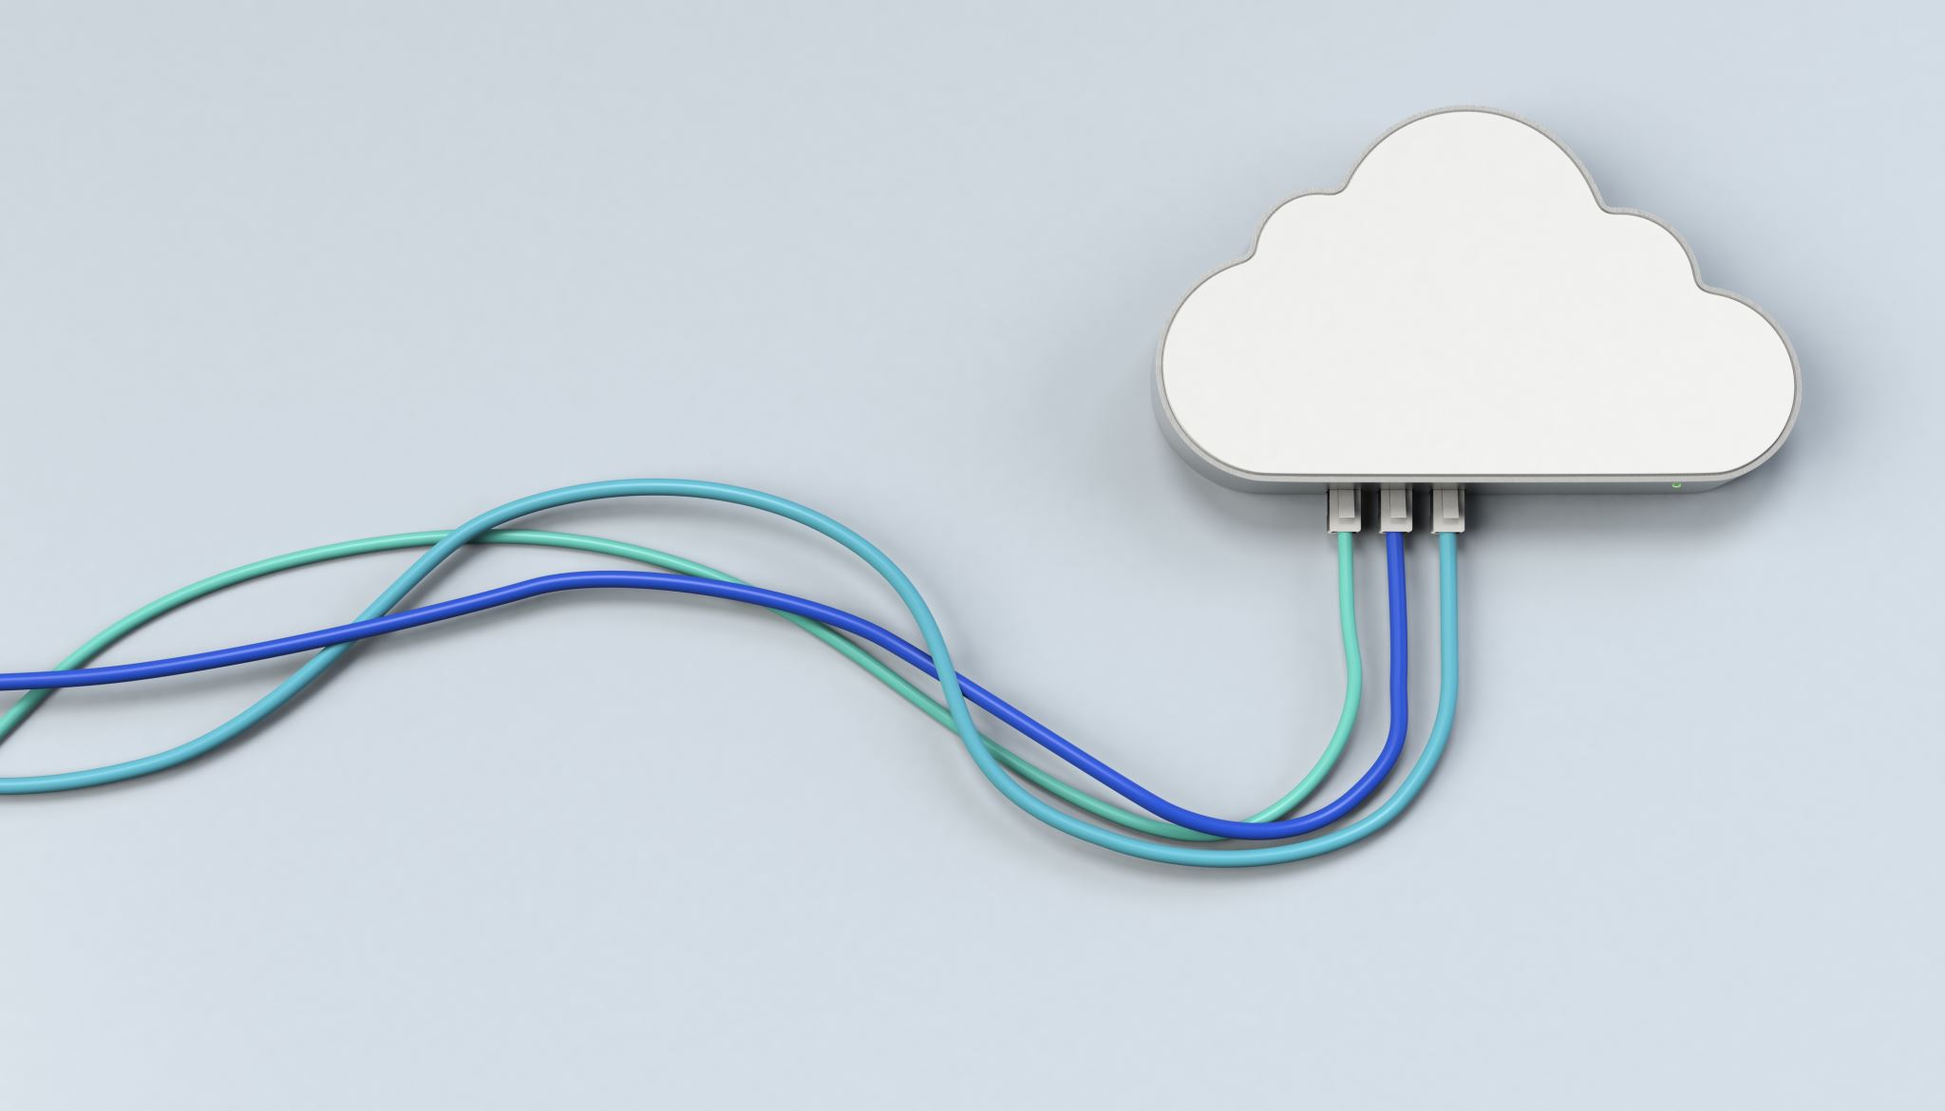
Conclusion
In conclusion, our sophisticated home security system represents a culmination of IoT technology and meticulous hardware integration. The heart of the system lies in the ESP32 microcontroller, acting as a central hub for Wi-Fi integration and IoT control. Leveraging the Blynk platform, two magnetic reed switches strategically placed on doors and windows serve as the primary sensors, while a servo motor ensures efficient door control, adding an extra layer of security. The ESP32-Cam extends the system's capabilities with a camera for surveillance, and LEDs and an active buzzer provide immediate visual and audible alerts.
Facing challenges, such as pin limitations on the ESP32-Cam and complications with data storage, the project adapted by incorporating an ESP32 connected to the ESP32-Cam via UART and opting for secure local storage on a micro-SD card. This not only addressed the constraints but also ensured a robust and private system. The programming aspect involves configuring the ESP32 with Arduino IDE, integrating essential libraries, and setting up Blynk for seamless IoT communication.

Slide 28
Future Work
In envisioning the future development of our home security system, a holistic approach can significantly enhance its capabilities and usability. Firstly, the integration of advanced environmental sensors, such as the MICS-6814 Gas Sensor Module and DHT22/AM2302 Digital Temperature and Humidity Sensor, would enable the system to monitor air quality, detect harmful gases like carbon monoxide (CO), nitrogen dioxide (NO2), and ammonia (NH3), as well as provide temperature and humidity data for comprehensive environmental awareness.
Moreover, incorporating light control using relays and photoresistors would add an extra layer of automation. This feature could optimize energy usage by adjusting lighting conditions based on ambient light levels, enhancing both security and energy efficiency. Additionally, fan control can be integrated, ensuring proper ventilation in response to environmental factors or user preferences, contributing to a more comfortable living environment.
In the realm of security, upgrading to a higher-quality camera with advanced features would enhance surveillance capabilities. A camera with better resolution, night vision, and motion detection could provide more detailed and reliable information for threat detection. The footage could be stored securely online, addressing the limitations of local storage and ensuring data accessibility from anywhere.
To achieve this, the system could leverage secure cloud storage solutions, implementing robust encryption and access controls to protect sensitive information. This not only facilitates remote access to captured images but also ensures data integrity and confidentiality.

Slide 29

REferences
[1] RandomNerdTutorials, “Getting started with the ESP32 Development Board,” Random Nerd Tutorials, https://randomnerdtutorials.com/getting-started-with-esp32/ (accessed Dec. 4, 2023).
[2] RandomNerdTutorials, “ESP32-cam save picture in Firebase Storage,” Random Nerd Tutorials, https://randomnerdtutorials.com/esp32-cam-save-picture-firebase-storage/ (accessed Dec. 4, 2023).
[3] DroneBot Workshop, “Using servo motors with the ESP32,” DroneBot Workshop, https://dronebotworkshop.com/esp32-servo/ (accessed Dec. 4, 2023).
[4] DroneBot Workshop, “Using the ESP32-cam microsd card,” DroneBot Workshop, https://dronebotworkshop.com/esp32-cam-microsd/ (accessed Dec. 4, 2023).
[5] esp32io, “ESP32 - door sensor,” ESP32 Tutorial, https://esp32io.com/tutorials/esp32-door-sensor (accessed Dec. 4, 2023).

Slide 30

Thank you for your attention!!!
Any questions?

